Slide 1
Back to School Meeting
September 5-6, 2023

Slide 2
Agenda
What is SkillsUSA?
The SkillsUSA Framework, The Program of Work, and CEP
Membership Registration and Information
Traditional vs. Affiliation
Leadership Events
Regional Meetings, Fall Leadership Conference
Competition Information
Contest Guide
Regional, State, and National Competitions
Student Leadership Opportunities
State Officers, Courtesy Corps, Glam Squad, Social Media Ambassadors, Branding Design Contest
Advisor Resources

Slide 3
What is SkillsUSA?
Career and Technical Student Organization
Integral to the success of CTE programs
Advisor-led, student-driven
SkillsUSA is America’s proud champion of the skilled trades. Our mission is to empower students to become world-class workers, career-ready leaders, and responsible community members.

Slide 4
The SkillsUSA Framework
Defines our mission
Personal Skills, Workplace Skills, Technical Skills Grounded in Academics
17 Essential Elements
Identified by industry as being the most important skills for career success
Provides a common language for students to articulate their experiences
Assesses skill development along a learning continuum of awareness, demonstration, and mastery
Creates a vision for SkillsUSA programming to ensure quality experiences for all members

Slide 6
The Program of Work
How our mission is actualized.
Helps to engage students in their school and community with real experiences, including work-based learning.
Chapter management tool to help advisors empower students.
Plan and execute events related to one of the six areas of the program of work, identify Essential Elements, work in committees, etc.

Slide 7
The Program of Work
Workplace Experiences
Career fair, job shadowing, SkillsUSA Championships
Partner and Alumni Engagement
Guest speakers, competition mentorship, sponsorship
Leadership Development
Chapter officer training, local leadership workshop
Advocacy and Marketing
Chapter social media, local news engagement
Financial Management
Financial literacy guest speaker, personal budgeting exercise
Community Engagement
Community service project, community open house

Slide 8
Chapter Excellence Program
How we recognize chapter excellence
Provides a roadmap to chapter success in implementing the Framework
Recognition is focused on the resulting development after the event
Quality Chapter
Chapters of Distinction (Gold, Silver, Bronze)
Models of Excellence
Applications online – due March 1

Slide 9
Membership Registration
Join members online at register.skillsusa.org.
Review instructions in the Chapter Success Guide to activate Member Enroll
Students enter their membership information, advisors submit and agree to invoicing terms
To be eligible for competition:
At least 6 students and 1 professional member
Registered by February 1 (check regional deadlines)
Paid by March 1
$16/student, $35/professional
Affiliation Plans available

Slide 10
Affiliation Plans
Total Participation Plan (TPP) – middle school, high school, college/postsecondary combined campuses
College Campus Affiliation Plan – college/postsecondary institutions
Reduced membership costs for full program/campus affiliation – must join all eligible students
Affiliation fee on a sliding scale
Educational resources credit – TPP only, $5.95 per student
Available for schools and school districts
https://www.skillsusa.org/join/how-to-join/

Slide 11
Affiliation Plan Example
Pricing, deadlines, and plan information
225 Students | Traditional Membership | TPP | College Campus
Affiliation Fee | $16/student | $1,312 | $3,360
Educational Resource Credit | N/A | $5.95 x 225 = $1,338.75 | N/A
Total Student Cost | $3,600 | $2,650.75 | $3,360
Professional Affiliation | 1/program | 1 per 100 | 1 per 25
Professional Affiliation Cost | 7 x $35 = $245 | 3 x $35 = $105 | 9 x $35 = $315
Total Cost | $3,845 | $2,755.75 | $3,675
Total Cost per Member | $16/$35 ($16.57, 232) | $12.09 (228) | $15.71 (234)

Slide 12
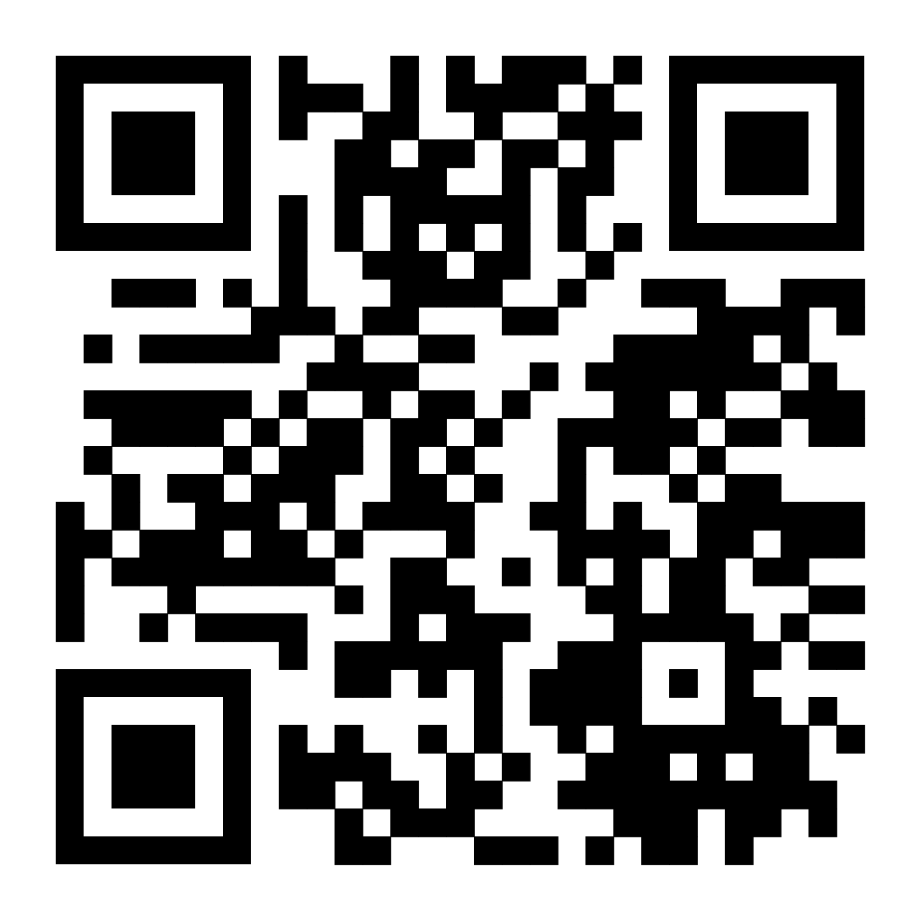
QUESTIONS?
New Member Enrollment Training
September 11 at 6 PM ET
September 12 at 10 AM ET
Sign up here: https://form.jotform.com/232225810687154

Slide 13
Event Registration
Register for events online at register.skillsusa.org
Must be registered members to register for competition
Follow steps in conference guides
Onsite Registration and Packet Pickup
FLC – Monday, November 6, 8 AM to 9 AM
SLSC – Sunday, April 14, 1 PM to 6 PM
NLSC – Monday, June 24, 4 PM to 6 PM
Bring required forms and outstanding payments
Code of Conduct Forms
Requires parent/guardian signature for under 18
1 per registered attendee
Approved Chaperone Form
Indicated school has approved those individuals to chaperone/supervise
Submit once per year, update as needed

Slide 14
Regional Leadership Meetings
Usually held in September. Dates and locations vary by region.
May include:
Regional officer elections
Steering Committee/Advisor meeting
Student professional development
Other activities
Check with your Regional Coordinator for more information.

Slide 15
Fall Leadership Conference (FLC)
November 6-7, 2023
Check in begins 8 AM Monday, adjourn 2 PM Tuesday
Hilton Melbourne, 200 Rialto Place, Melbourne, FL
State leadership training activity
Essential elements: Teamwork, Planning, Organizing and Management, and Adaptability/Flexibility
Student track – Maximize
Open to chapter officers, regional officers, chapter leaders, and any students looking to grow their chapter and career readiness skills
Advisor track – Chapter Management Institute (CMI)
Open to new, nearly new, and not-so-new advisors

Slide 16
Fall Leadership Conference (FLC)
MAXIMIZE
Students are divided into Conference Chapters, where they learn to work in committees, operate effective chapter meetings, and plan and execute a skit for the Lip Sync Battle.
As a result of participation, students will learn how to plan, execute, and evaluate a chapter activity focused on developing a Framework skill.
Chapter Management Institute (CMI)
Advisors dive deep into what SkillsUSA is, what it means to be an advisor, and how to build and grow your chapter
Learn to implement resources like the Business Partner Guide, and to earn recognition through the Chapter Excellence Program
Best practices discussions and networking sessions
Facilitated by SkillsUSA national facilitator

Slide 17
Fall Leadership Conference (FLC)
FLC23 Conference Guide
Full agenda, registration info, deadlines, and other details
Registration Open Now!
Registration Closes/ Rooming List Due: October 2
Payment due: October 30
Package cost based on room occupancy.
Includes:
1 night hotel (extra nights available for additional fee)
Conference registration and materials
Monday lunch and dinner; Tuesday breakfast and lunch; snacks
Conference shirt and other swag
Single: $450/person
Double: $375/person
Triple: $350/person
Quad: $325/person
Additional Room Night: $135/room/night

Slide 18
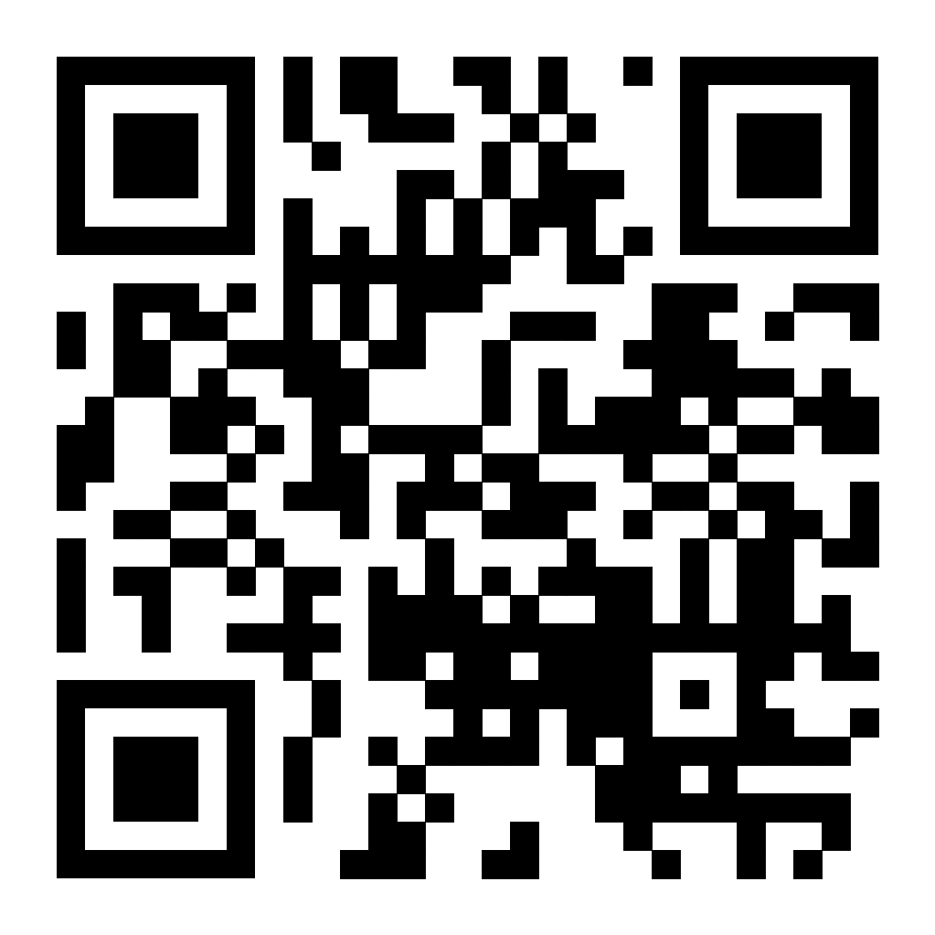
QUESTIONS?
Fall Leadership Conference Guide
Registration Closes October 2
Payment Due October 30
https://www.skillsusafl.org/wp-content/uploads/2023/09/2023-Fall-Leadership-Conference-Guide-FINAL.pdf

Slide 19
Competition Information
2023-2024 Contest Guide
Available now! – skillsusafl.org/resources
Eligibility
State Competition List and Description
Review this list to prepare for the year!
How to Prepare
Middle School, Florida-Only, and Special Needs competitions
New state and national competitions
Grievances and Scoring

Slide 20
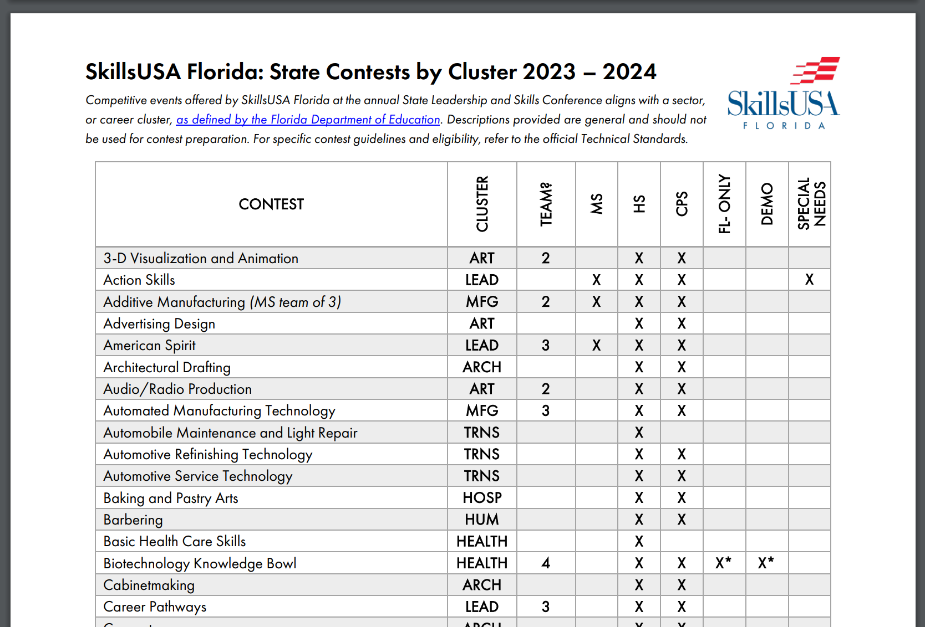

Slide 21
Competition Information - Updates
Review the list of contests – submit requests by December 1
New Contests
Commercial Roofing
New Contests with Caveats
Biotechnology Knowledge Bowl
Wedding Cake Design – National competition
Hair Weave – Natural Hair Design and Braids – National competition
E-sports*

Slide 22
Regional Competitions
February, date and location varies by region
Some regions require Intent to Enter forms
Refer to Chapter Success Guide for links and info.
Intent to Enter is not a registration – planning purposes only
Registration deadlines may occur prior to winter break – be sure any memberships are entered prior to registration deadlines!
Official state deadline is February 1
Each region is assigned invitations per contest to maximize participation at the state level. Regional Coordinator will distribute the invitations.

Slide 23
State Competitions
State Leadership and Skills Conference (SLSC)
April 14-17, 2024
Jacksonville, FL
Competitions held at:
Hyatt Regency
Florida State College at Jacksonville Downtown Campus
Prime Osborn Convention Center (expanded offerings)
Professional development, community service, Meet the Employer Career Fair, CONNECTED Expo and Trade Show, Champions Night Celebration, and more!

Slide 24
SLSC24 – Registration Info
Registration Opens: February 1
Registration Closes: March 4, 2024, 11:59 PM
No drops or refunds after this time – invoices are final
Hotel Reservation Deadline: March 11, 2024
Hyatt Regency Jacksonville Riverfront - $173/night
Hotel reservations online – conference guide and website
Schools make own reservations and payment arrangements
Communicate often and early with hotel!
Registration Payment Deadline: March 18, 2024
Check payment preferred
Credit card payments automatically include processing fee
currently 3.3%
Payment must be received prior to participation!

Slide 25
SLSC24 – Registration Info
Registration Information
$150 per person, including contestants, advisors, models, and observers who will attend Opening and Closing ceremony
Courtesy Corps Members: $50 (CC Leadership Team – no cost)
Includes:
Conference pin and t-shirt
Access to contest floor, Opening and Closing Ceremonies
Conference transportation between venues
Champions Night Celebration (including dinner)
Lunch for contestants and models during competition
Professional Development sessions for students and advisors
All other conference activities
Special events for advisors
NEW THIS YEAR: Day Pass available. $35 per day, 4/15-16 only, purchase onsite. No access to opening or closing ceremonies.

Slide 26
SLSC24 – Opening Ceremony
Opening Ceremony
Sunday, April 14, 2024
Florida Theatre
Doors open at 6:30 PM, Ceremony begins at 7 PM
State Level Awards
Keynote speaker
Last minute reminders and announcements
Attendance limited to conference attendees and partners.

Slide 27
SLSC24 – Conference Schedule
Conference Activities – April 15 – 16
Professional Development – 10 AM to 2 PM
Competitions – 8 AM – 4 PM
CONNECTED Expo and Trade Show – 8 AM to 2 PM
Advisor Lounge – 7 AM to 4 PM
Community Service – TBD
Meet the Employer Career Fair – April 15, 5 PM to 8 PM
Delegate Sessions – 3 PM to 5 PM
Framework Luncheon – April 16, 12 PM to 2 PM
Champions Night Celebration and Advisor Reception – April 16, 6 PM to 10 PM

Slide 28
SLSC24 – Closing/Awards Ceremony
Closing Ceremony
April 17, 2024
Hyatt Regency Jacksonville Riverfront
Live streaming will be available for public viewing
Attendance limited to conference attendees and invited partners.
Doors open at 7:30 AM
Ceremony begins at 8:30 AM
Gold medalists complete Intent to Enter form for NLSC
Immediately following, NLSC Delegation Meeting @ Hyatt
Adjourn by 1 PM

Slide 29
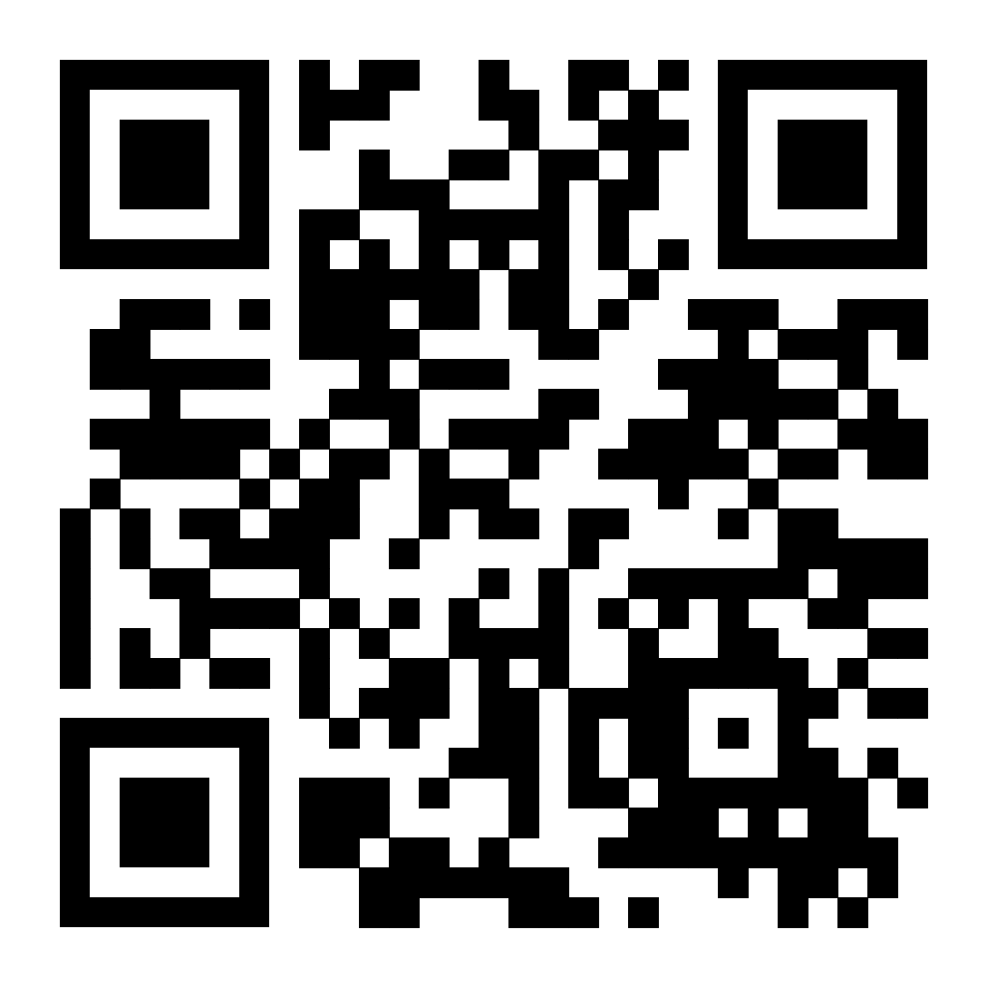
QUESTIONS?
Contest Guide
Contest List and Descriptions, eligibility, and important links and information
https://www.skillsusafl.org/wp-content/uploads/2023/08/2023-2024-Contest-Guide-FINAL.pdf

Slide 30
Leadership Opportunities for Students
State Officers
Courtesy Corps
Glam Squad
Social Media Ambassadors
Branding Design Contest

Slide 31
Leadership Opportunities for Students
State Officers
Student leadership team elected during state conference to serve for one program year
Candidates submit application in advance, and campaign during SLSC Delegate Sessions
Marketing materials, campaign speech, problematic questions
Lead state and regional events
Facilitation, community service, etc
Engage in advocacy training and practice
Support local chapters to promote chapter development
Application and Program Guide available November 1
https://www.skillsusafl.org/about/state-officers/

Slide 32
Leadership Opportunities for Students
Courtesy Corps
Logistics team working behind the scenes to ensure events are successful
Serve at local, state, and national events
Competition at SLSC to determine the NLSC Delegation
Travel to NLSC all expenses paid (bus transport, registration, lodging)
Two Opportunities:
Leadership Team – Application due November 15, arrive early to SLSC and participate all expenses paid
Courtesy Corps Member – Application due by March 4, arrive and stay with school and pay reduced registration fee ($50)
Program Guide and Application available now!

Slide 33
Leadership Opportunities for Students
Glam Squad
Cosmetology students work as hair and make up artists for the State Officer Team and VIPs at the Opening and Closing Ceremony at SLSC
Students may work hair, makeup, or both
Application link in SLSC24 Guide. Includes submission of portfolio photos.
Due by March 4. Applicants notified by March 8.
Glam Squad receives:
Complimentary conference registration
Dinner Sunday and breakfast Wednesday
All-access pass for Opening and Closing Ceremonies
Does not interfere with competitions

Slide 34
Leadership Opportunities for Students
Social Media Ambassadors
Team of students responsible for social media content during SLSC, which may include Instagram and Facebook, reels/ TikTok, and other outlets.
Receives responsible social media training and best practices
Open to students in any trade area with passion for social media
Application available in SLSC24 Guide. Includes listing publicly accessible, well-established channels with appropriate content.
Due by March 4. Applicants notified by March 8.
Ambassadors receive:
Complimentary conference registration
Dinner Sunday and breakfast Wednesday
All-access pass to the SLSC
Schedule can be adjusted to accommodate for competition

Slide 35
Leadership Opportunities for Students
Branding Design Contest
Students submit a design package to represent the state theme
SkillsUSA Florida: Cruising Through Challenges
Must be a cohesive design package
T-shirt, Trading pin, Banner, Conference app homepage
Voting at the Fall Leadership Conference
Designs presented at Opening Session
Online voting for 24 hours, in-person voting at Lip Sync Battle
Winner announced during Closing Session of FLC
Comp registration for SLSC, swag bag and recognition during Opening Ceremony
Contest standards and design specs available now!
Due October 15, 2023

Slide 36
National Competitions
National Leadership and Skills Conference (NLSC)
June 24-28, 2024
Atlanta, GA
Hyatt Regency Atlanta*
Competitions at Georgia World Congress Center
Opening and Closing Session at State Farm Arena
SkillsUSA University, TECHSPO, Delegate Sessions and Training, Academy of Excellence, Champions Night, and more!
* pending confirmation

Slide 37
NLSC24 – Registration Information
Registration and Hotel Opens: At the conclusion of SLSC
Register online – register.skillsusa.org
Hotel reservations online – Passkey
Schools make hotel reservations; State Office invoices for package and collects payment
Schools arrange for travel and transfers to Atlanta
Registration and Hotel Deadline: May 6, 2024, at 11:59 PM
No drops or refunds after this time – invoices are final
Payment Deadline: May 27, 2024
Check payment preferred
Credit card payments automatically include processing fee
currently 3.3%

Slide 38
NLSC24 – Registration Information
Official Delegation Information
Contestants, models, advisors and chaperones, or anyone else who will reserve hotel rooms within the state block
If someone is staying at the hotel within our block, they MUST be registered through the state office – including parents and admin.
Schools may ONLY book at the official state hotel.
Students of all ages may not attend without school-provided supervision, including adults.
Must register for a full package thru state office by May 6
Does not include General Attendees:
i.e., Parents or observers the school is not financially responsible for; those who will not stay at the hotel or attend the full event, etc.

Slide 39
NLSC24 – Registration Information
Registration Information
Package price based on room occupancy
*estimates for budgeting purposes only. Final prices by Feb. 1
Single - $1,700/person
Double - $1,100/person
Triple - $930/person
Quad - $830/person
Includes:
5 nights hotel, including taxes and fees (parking not included, extra room nights for additional fee)
Conference pin and t-shirt, plus extra pins for trading
Access to contest floor, Opening and Closing Ceremonies
Champions Night Celebration
Lunch for contestants and models during competition
SkillsUSA University and Academies of Excellence
All other conference activities
SkillsUSA Florida swag and spirit items
State Welcome Dinner on Monday and Celebration Dinner on Friday

Slide 40
NLSC24 – General Agenda Overview
June 22-24 – Pre-conference activities
Leverage, Activate, Engage
June 24 – Mandatory State Meeting, 6 PM
June 25 – Opening Session, 5 PM
June 25 – 27 – Contest/ Orientations, 8 AM
SkillsUSA University, TECHSPO, Delegate activities, and other conference activities
June 27 – Champions Night Celebration
June 28 – Closing and Awards Ceremony, 5 PM
June 29 – Travel Home

Slide 41
NLSC24 – State Activities
Mandatory State Meeting – Monday, June 24 at the state hotel at 6 PM
Dinner is served!
Plan to arrive in Atlanta by 4 PM to account for traffic and delays
State Celebration Dinner – Friday, June 28 at the state hotel immediately following Closing Ceremony
Dinner is served!
Skill Point Certificates awarded
Additional awards and recognition
A giant sigh of relief
Opening and Closing Ceremonies will be live streamed for public viewing

Slide 42
Advisor Resources
Skillsusafl.org/resources
Contest Guide
Chapter Success Guide
All Conference Guides (FLC, SLSC, NLSC)
Branding Contest Standards
All meeting recordings and PowerPoints
Required paperwork (updated for 23-24)
Code of Conduct forms (for students and advisors)
Approved Chaperone Form

Slide 43
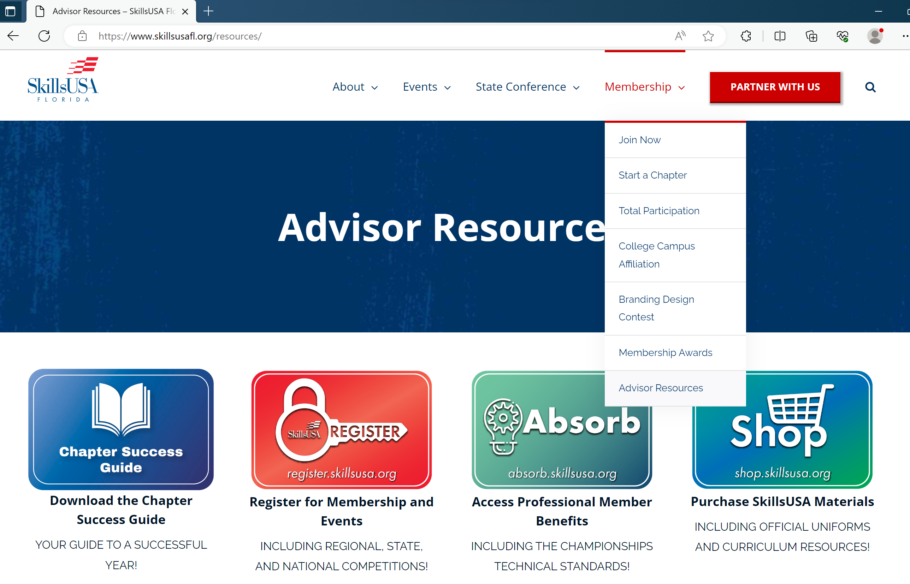
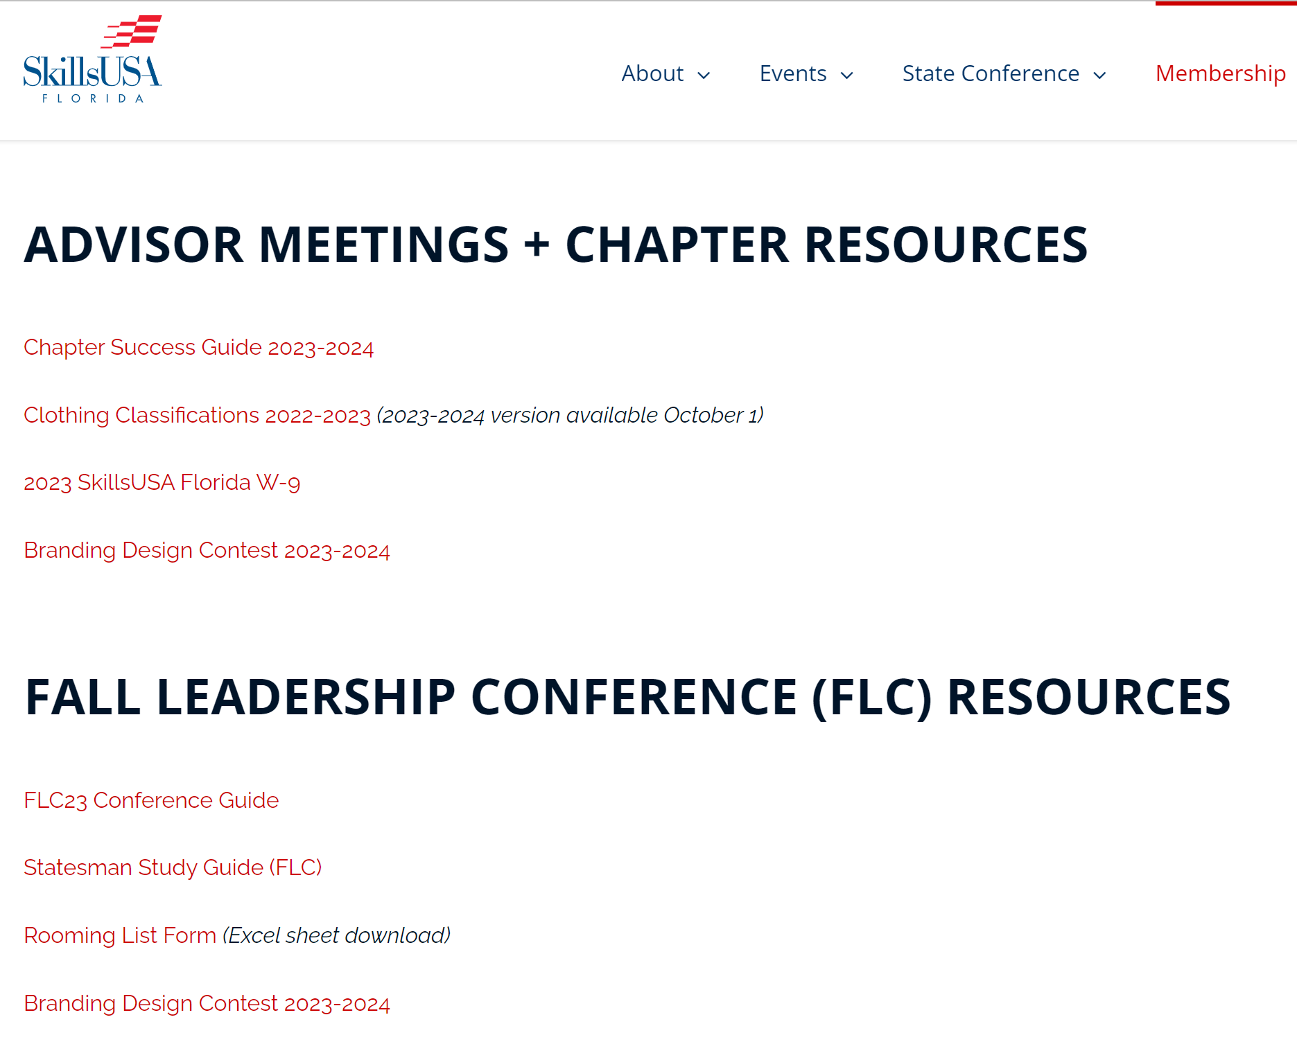

Slide 44
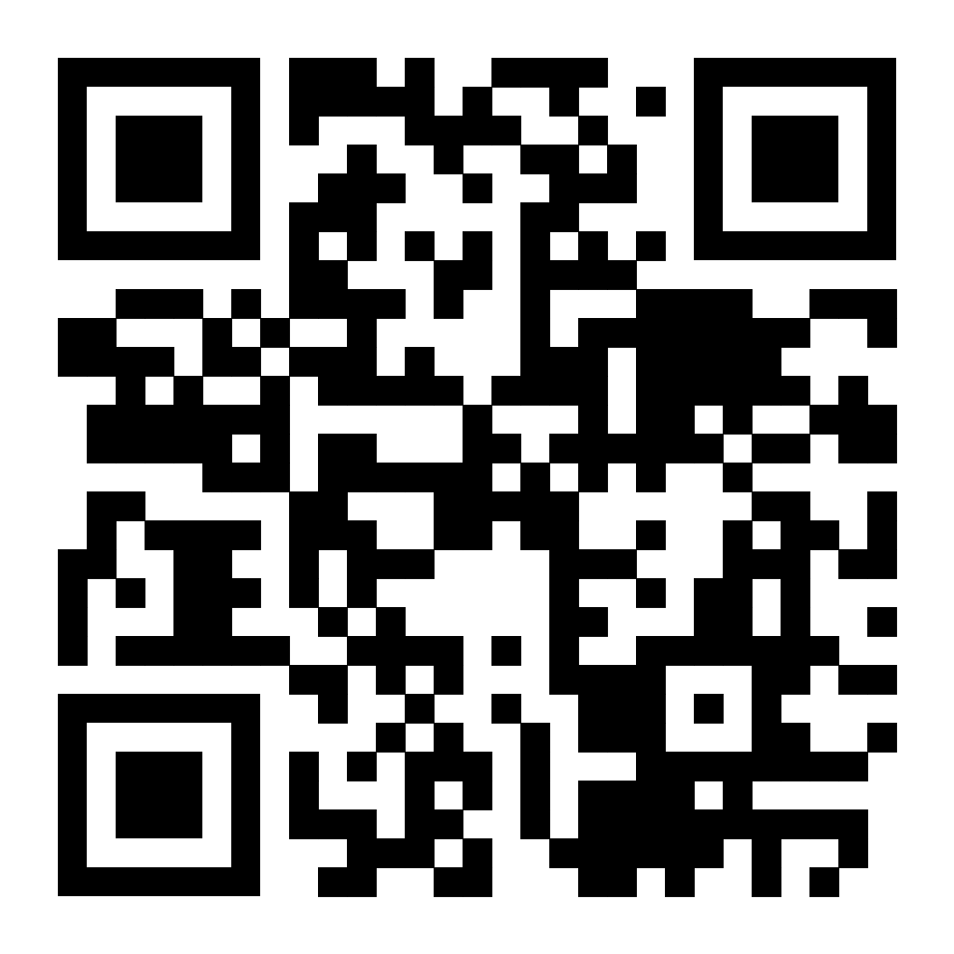
Reach Out Anytime!
Jessica Graber
State Director
jgraber@skillsusafl.org
(850) 284-8534
Schedule a Time to Meet!
Complete This Survey, Win $100!
Enter by 9/22

